Slide 1
Opening a window
Hosein Ghahremanzadeh
Notes:
The background is a sample of volumetric lighting in my own 3D graphics engine, HG3D

Slide 2

Steps
Describe the pixel format
Define a window
Ask OS for a window
Get a device context
Get OpenGL context from the device context
Handling events

Slide 3
Libraries for opening windows
GDI (for Windows)
SDL (Cross platform)
GLFW (Cross platform)
FreeGLUT(Cross platform)
SFML(Cross platform)
Notes:
Native libraries and tool are recommended for context creation. Since most of the libraries use a frame buffer object instead of rendering directly to the default frame buffer, which can be costly performance wise.
I am going to use GDI for windows and GLFW for other OS’s.

Slide 4
Pixel format description
Describes:
Color bitdepth
Stencil bitdepth
Depth bitdepth
Accumulation buffer bitdepth
OpenGL support
Double buffer
Stereo
Notes:
Pixel description commonly describes the attribute of the default frame buffer.
It’s not guaranteed that the final pixel description will be the exact description that was asked for.

Slide 5
Color bitdepth
Usually 8 bits for each color
Depends on limitation of the display (can be higher, but usually wasteful)
Notes:
The window’s color bitdepth better be the same as the display’s color bitdepth. This will minimize the VRAM used by the window, and will need less band width to update the window.
HDR rendering requires higher color precision and thus higher bitdepth; However the main rendering is often done on a frame buffer, and the content is then copied to the default frame buffer for the final display, which makes it wasteful to allocated higher bitdepth to default frame buffer than the display supports.

Slide 6
Stencil bitdepth
Describes the bitdepth used for the stencil buffer, on the frame buffer
Usually not used and set to 0.
Notes:
It’s usually set to 0 since the main rendering is done on a frame buffer object.

Slide 7
Depth bitdepth
This effect the precision of the depth test.
Most of the times depth test is not done on the default frame buffer, so it can be set to 0.
Notes:
Same as stencil buffer this is usually set to 0 due to main rendering taking action on a frame buffer object.

Slide 8
Accumulation buffer bitdepth
Accumulation buffer is used to rendering several images and blending them at a time.
Notes:
This can be useful for temporal anti-aliasing.
This is also often set to 0 due to same reason.

Slide 9
OpenGL support
Whether the allocated memory is going to support OpenGL or not is described as well.
Notes:
For our use this is always set to true.

Slide 10
Double Buffer
Rendering to a buffer that is being displayed will disturb the visible buffer.
Solution is to render to different buffer and swap the buffers after a frame is rendered.
Notes:
Changing the visible buffer can be disturbing to the user.
Rendering to a different buffer and swapping the buffers after rendering is done, allows rendering without disturbing the visual buffer.
This buffers are called back and front buffers.

Slide 11
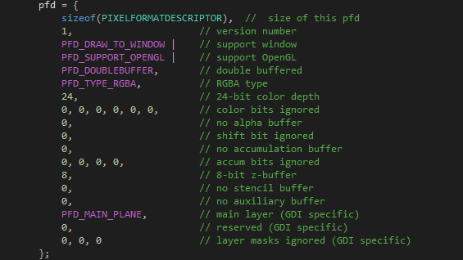
Pixel format descriptor on Windows
Description is stored on PIXELFORMATDESCRIPTOR structure.
Notes:
On windows we use GDI.
PIXELFORMATDESCRIPTOR is a GDI structure used to describe pixel format. More info on MSDN.

Slide 12
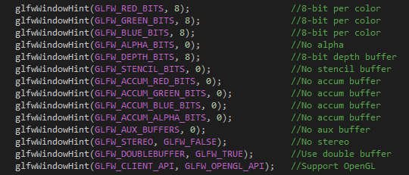
Pixel format descriptor on GLFW
Description is hinted via glfwWindowHint function.
Notes:
For other platforms we’re going to use GLFW.
More info on the hint function on GLW documentation.

Slide 13
Event handling
Events are handled through callbacks.
Each even will pass proper values depending on the event.
Two method of event Handling:
Polling
Waiting for event
Notes:
A callback will be called with proper values for each event, through which the program is informed about the event.
On polling, the program checks whether there has been an event or not, whereas on waiting, the thread goes to sleep until an event occurs.

Slide 14
Event handling on Windows Callbacks:
On Windows a single callback is called for every event.
The description of the event is passed to callback function as input parameter.
The signature of the callback function should be as follows:

Slide 15
Event handling on GLFW Callbacks:
On GLFW there are separate callbacks for different events.
The description of the event is passed to callback function as input parameter.
There is a full description of these callbacks on GLFW documentation.

Slide 16
Polling and waiting
For waiting GetMessage function is call on Windows, and glfwWaitEvents is called on GLFW
For polling PeekMessage is called on Windows and glfwPollEvents is call on GLFW.

Slide 17
Your questions

Slide 18
Helpful links
http://www.opengl-tutorial.org/beginners-tutorials/tutorial-1-opening-a-window/ (Opening a window)
https://msdn.microsoft.com/en-us/library/windows/desktop/dd368826(v=vs.85).aspx (Pixel format descriptor)
http://www.glfw.org/docs/latest/group__window.html#ga7d9c8c62384b1e2821c4dc48952d2033 (glfwWindowHint )
https://msdn.microsoft.com/en-us/library/windows/desktop/ms633573(v=vs.85).aspx (Windows callback)
http://www.glfw.org/docs/latest/group__window.html#typedef-members (GLFW callbacks)
https://msdn.microsoft.com/en-us/library/windows/desktop/ms644936(v=vs.85).aspx (GetMessage)
https://msdn.microsoft.com/en-us/library/windows/desktop/ms644943(v=vs.85).aspx (PeekMessage)
http://www.glfw.org/docs/latest/group__window.html#ga554e37d781f0a997656c26b2c56c835e (glfwWaitEvents)
http://www.glfw.org/docs/latest/group__window.html#ga37bd57223967b4211d60ca1a0bf3c832 (glfwPollEvents)
Notes:
http://www.opengl-tutorial.org/beginners-tutorials/tutorial-1-opening-a-window/ (Opening a window)
https://msdn.microsoft.com/en-us/library/windows/desktop/dd368826(v=vs.85).aspx (Pixel format descriptor)
http://www.glfw.org/docs/latest/group__window.html#ga7d9c8c62384b1e2821c4dc48952d2033 (glfwWindowHint )
https://msdn.microsoft.com/en-us/library/windows/desktop/ms633573(v=vs.85).aspx (Windows callback)
http://www.glfw.org/docs/latest/group__window.html#typedef-members (GLFW callbacks)
https://msdn.microsoft.com/en-us/library/windows/desktop/ms644936(v=vs.85).aspx (GetMessage)
https://msdn.microsoft.com/en-us/library/windows/desktop/ms644943(v=vs.85).aspx (PeekMessage)
http://www.glfw.org/docs/latest/group__window.html#ga554e37d781f0a997656c26b2c56c835e (glfwWaitEvents)
http://www.glfw.org/docs/latest/group__window.html#ga37bd57223967b4211d60ca1a0bf3c832 (glfwPollEvents)

